Slide 1
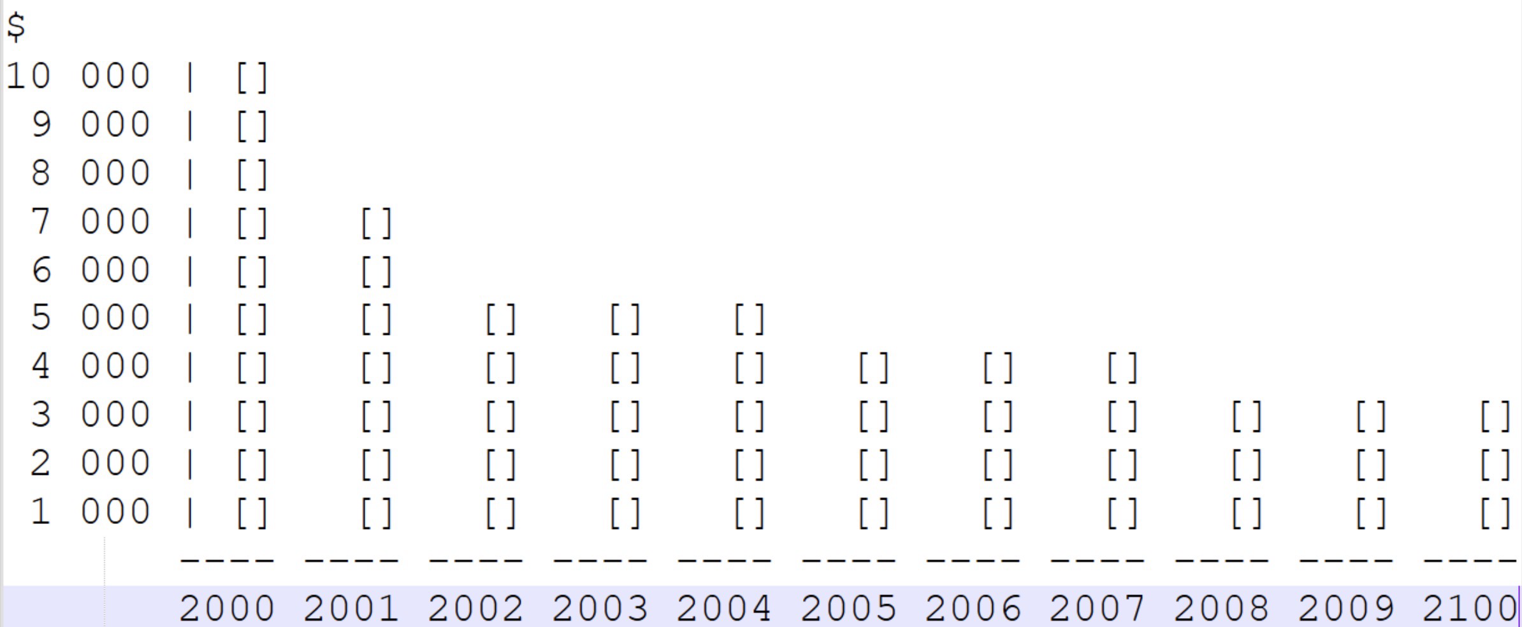
Car depreciation
The graph above shows the rate of the depreciation of the car price
From here, we can see that the car loses 50% of it’s value in the first 3 years, while the depreciation rate stabilizes in the next few years.
In this graph, we can see that this car has lost 70% of it’s value after 10 years.
According to our calculations, this is the formula to calculate the depreciation rate of the car.
First 3 years: ((car value)/2)-((car value)/1.8)=yearly depreciation rate
Next few years: (((car value)/3)*((car value)/0.1))-3=yearly depreciation rate

